Slide 1





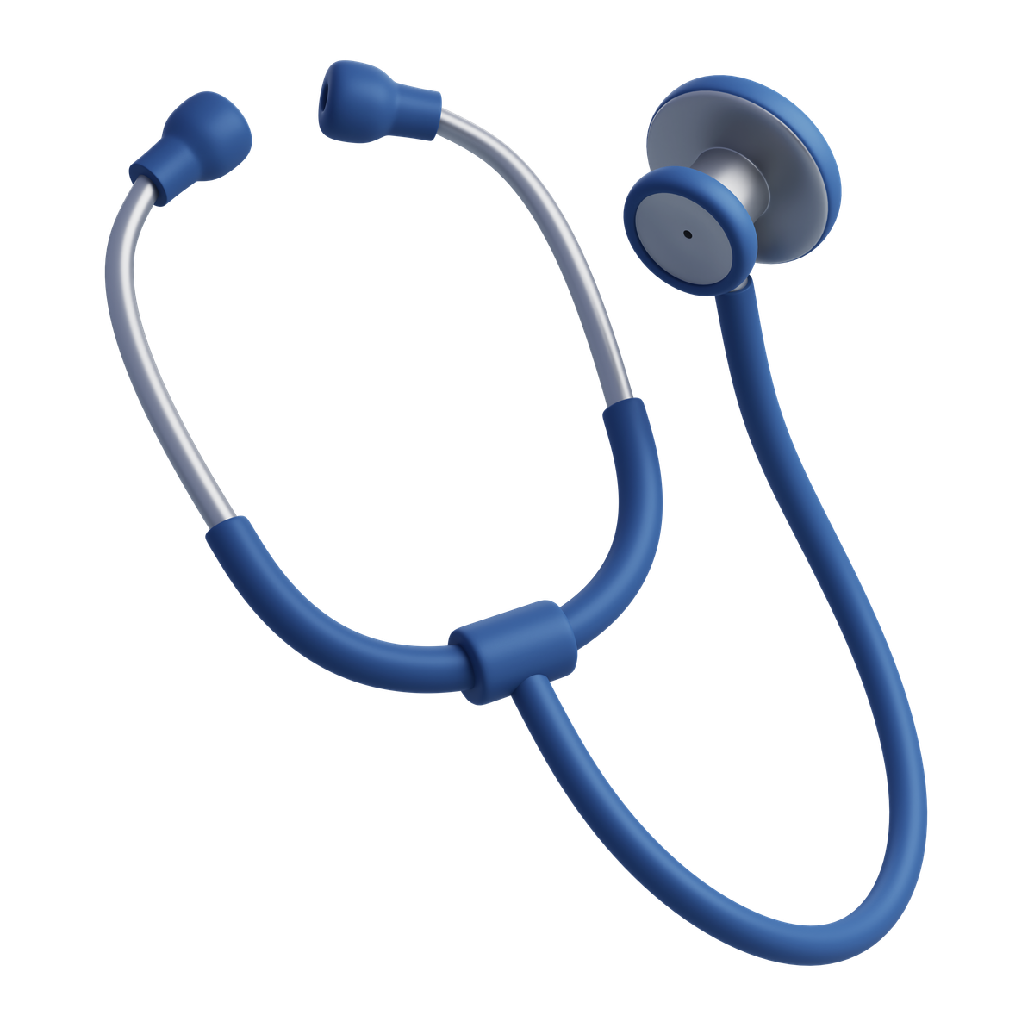
DOCUMENTATION OF
MedTrack_DV
HOSPITAL PERFORMANCE INTELIIGENCE SYSTEM FOR OPERATIONAL AND PATIENT CARE ANALYTICS

Slide 2



Introduction
MedTrack_DV is a Tableau-based Hospital Operations & Patient Analytics Dashboard that analyzes hospital and patient data.
It provides interactive dashboards for Hospital Overview, Patient Flow, Department Analytics, and Resource Utilization to support data-driven hospital management.

Slide 3


Problem Statement
  Hospitals generate large amounts of patient, admission, department, and resource data, which can be difficult to manage and analyze.
  Raw healthcare data may contain missing values, inconsistencies, and other data-quality issues.
  MedTrack_DV cleans, transforms, and analyzes the data to monitor patient flow, department performance, resource utilization, and hospital performance.
  The results are presented through interactive Tableau dashboards, providing a unified view of hospital operations.

Slide 4

Project Objective
  Integrate, clean, and transform hospital and patient datasets for reliable analysis.
  Develop KPIs and insights for patient flow, hospital performance, department efficiency, and resource utilization.
  Build four interactive Tableau dashboards covering the major hospital operational areas.
  Provide a unified analytical solution through a single Tableau workbook to support data-driven decision-making.

Slide 5





Technology & Tools Stack Used
EXCEL
PYTHON
POWER BI
GITHUB
  Used to view and validate raw and cleaned datasets before and after the data-cleaning process.
  Helped in reviewing data structure, values, and overall data quality.
  Used for data cleaning, transformation, missing-value handling, and outlier treatment.
  Pandas was used to prepare the final processed datasets for analysis.
  Used to develop interactive dashboards and visualize hospital KPIs and insights.
  Helped present hospital performance, patient flow, department analytics, and resource utilization.
  Used for project version control, collaboration, and maintaining project files.
  Provided a centralized platform for showcasing and submitting the project work.

Slide 6





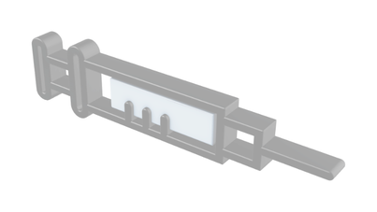
Core Features Of Project
MedTrack_DV Dashboard
HOSPITAL PERFORMANCE MONITORING
Track patient movements, transfers, department activity, and patient flow patterns.
PATIENT FLOW MONITORING
Monitor key hospital KPIs, performance trends, and overall operational performance.
RESOURCE MANAGEMENT
Monitor bed, equipment, and staff utilization along with department efficiency and resource availability.

Slide 7

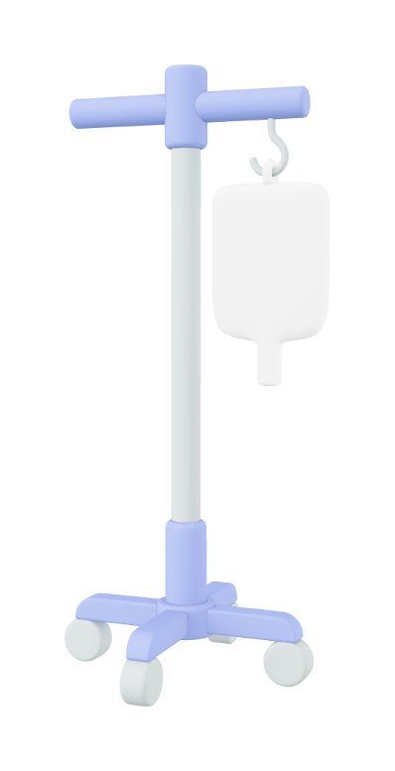

Challenges Faced By Hospital Management
Scattered Data
Hospital data is distributed across different datasets, making it difficult to get a unified view of hospital operations and performance.
Limited Operational Visibility
Staff and administrators may find it difficult to monitor patient flow, department performance, and important hospital KPIs in one place.
Difficult Resource Management
Tracking the utilization of beds, equipment, and staff manually can make it harder to identify resource shortages or underutilization.
Time-Consuming Reporting
Preparing reports and comparing performance across hospitals, departments, and different time periods can require considerable manual effort.

Slide 8
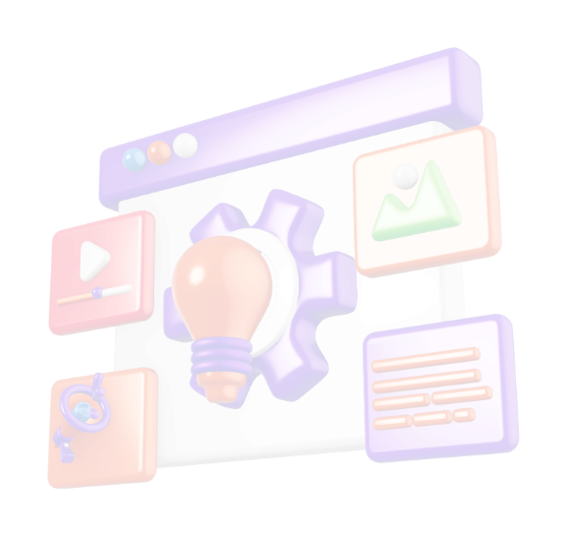

DashBoard Architecture
The dashboard provides a comprehensive view of hospital operations through four key analytical views, each focusing on a specific aspect of hospital management.
HOSPITAL OVERVIEW
PATIENT FLOW
DEPARTMEN ANALYSIS
RESOURCE UTILIZATION
HOME
SELECTING ONE VIEW LEAD YOU TO THE RESPECTIVE DASHBOARD

Slide 9
Solutions in This
Dash Board
Hospital Performance Monitoring
Provides a centralized view of hospital KPIs and helps administrators monitor overall operational performance.
Patient Flow Tracking
Provides visibility into patient movements, transfers, and department activity to better understand patient flow
Department Performance Analysis
Helps identify department-level performance and efficiency by analyzing admissions, occupancy, LOS, and other key metrics.
Resource Utilization Monitoring
Provides insights into the utilization of beds, equipment, and staff to support better resource management.

Slide 10
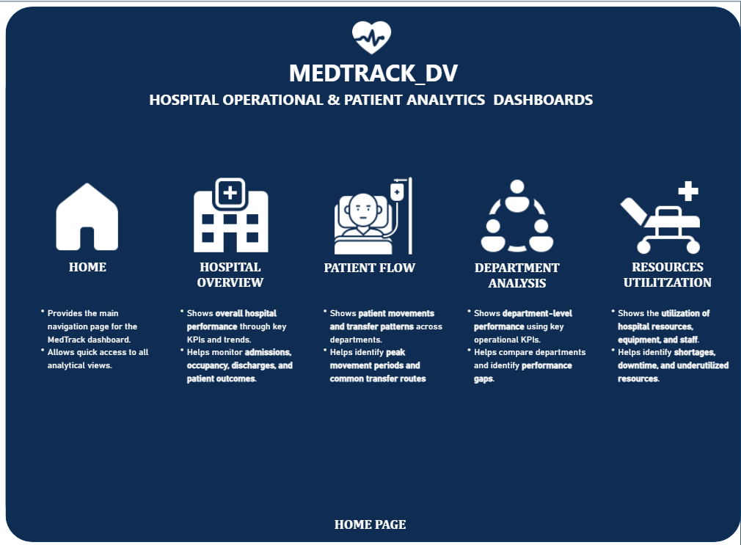
Home Page :-
  Central Navigation Hub – Provides quick access to all major MedTrack_DV dashboard views.
  Hospital Overview – Gives a summary of hospital performance through key KPIs and trends.
  Patient & Department Analysis – Provides quick access to patient movement and department performance insights.
  Resource Utilization – Provides access to resource utilization analysis, including equipment, beds, and staff.

Slide 11
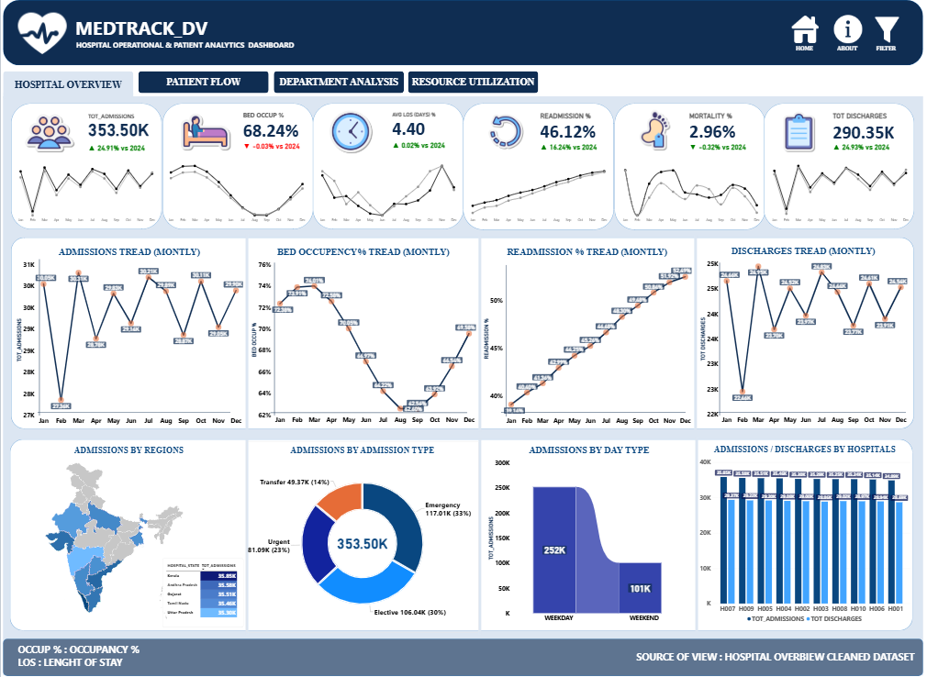
Hospital Overview :-
  Hospital KPI Monitoring – Provides a centralized view of admissions, occupancy, LOS, readmission, mortality, and discharge KPIs.
  Monthly Performance Trends – Tracks monthly changes in admissions, bed occupancy, readmissions, and discharges.
  Admission & Discharge Analysis – Analyzes admissions by region, admission type, day type, and hospital-wise admissions and discharges.
  Performance Comparison – Helps compare hospital activity and identify changes in operational performance across different periods and locations.

Slide 12
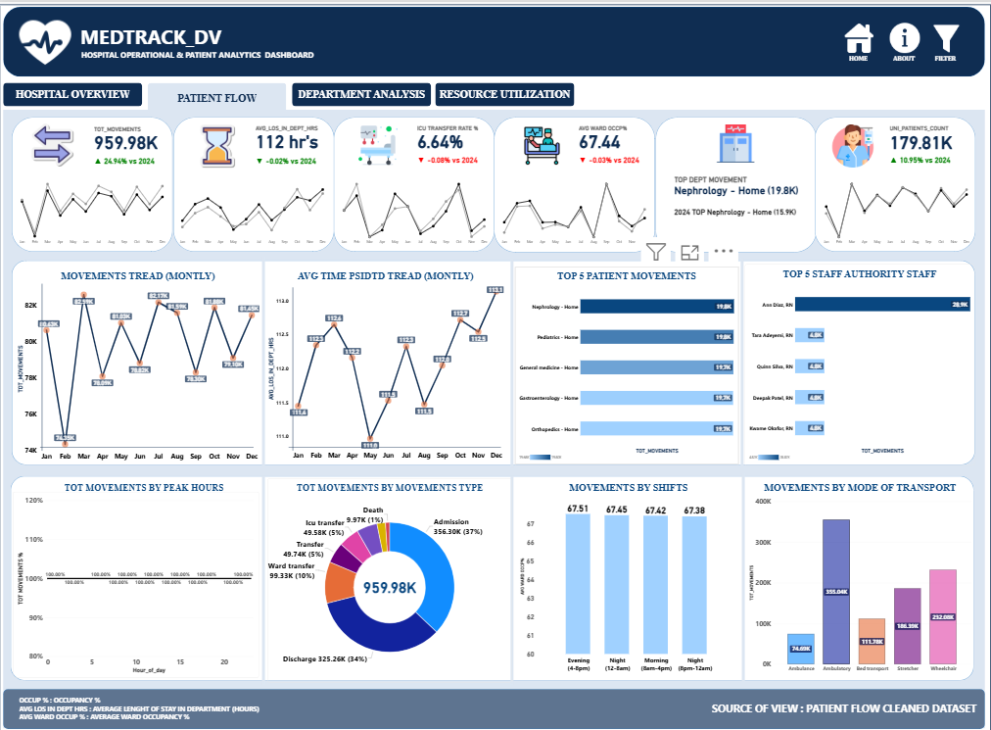
Patient Flow :-
  Patient Movement Monitoring – Tracks total patient movements, average time spent in departments, ICU transfers, and ward occupancy.
  Movement Pattern Analysis – Identifies the most common patient movement routes and transfer patterns between departments.
  Staff & Movement Analysis – Highlights staff authorities involved in patient movements and analyzes movement types and shifts.
  Transport & Peak-Time Analysis – Examines patient movements by peak hours and mode of transport to understand patient flow patterns.

Slide 13
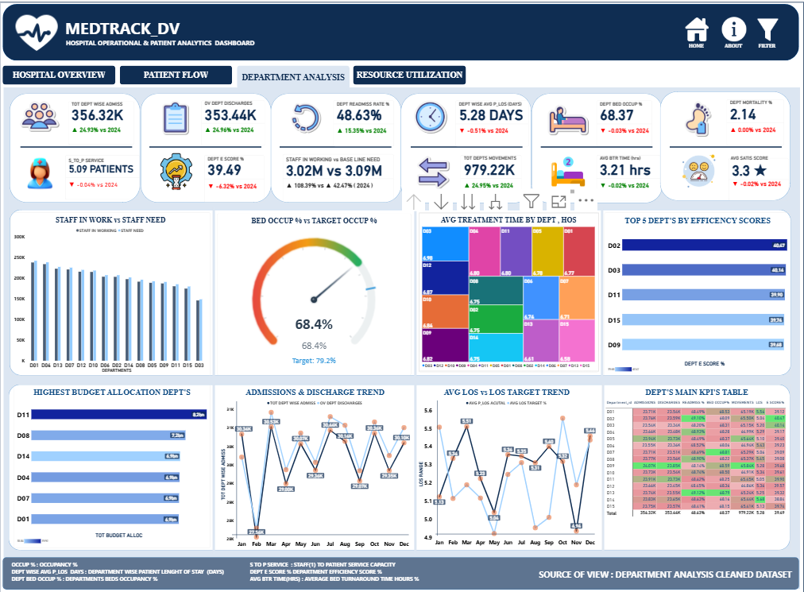
Department Analysis :-
  Department KPI Monitoring – Tracks admissions, discharges, readmissions, LOS, occupancy, mortality, and other key department metrics.
  Department Efficiency Analysis – Compares departments using efficiency scores, staff requirements, bed occupancy, and service performance.
  Treatment & Capacity Analysis – Analyzes treatment time, staff availability, bed occupancy against targets, and department capacity.
  Department Performance Trends – Monitors admissions, discharges, LOS, budgets, and key departmental KPIs over time.

Slide 14
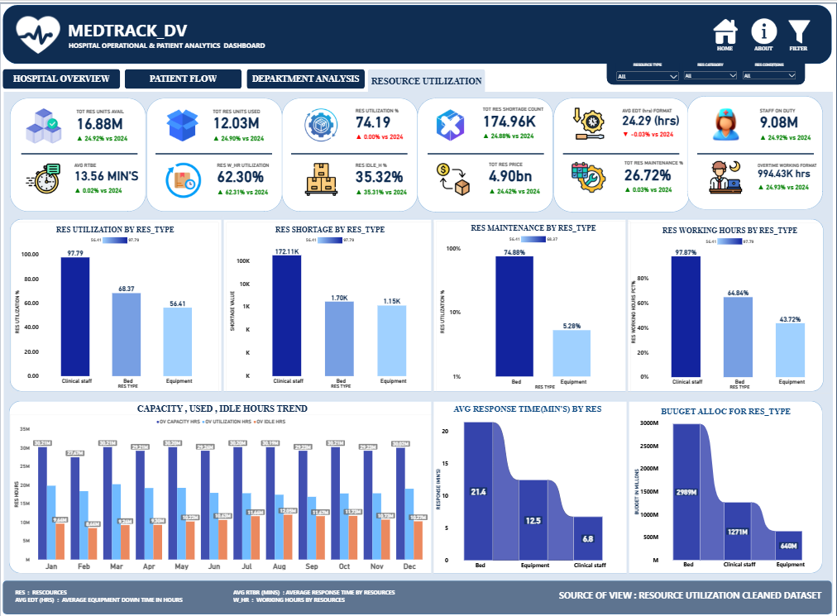
Resource Utilization :-
  Resource Utilization Monitoring – Tracks the utilization of beds, equipment, and clinical staff across the hospital.
  Resource Availability & Shortage Analysis – Identifies resource shortages, idle resources, and overall resource availability.
  Maintenance & Working Hours Analysis – Monitors resource maintenance, downtime, and working hours to support operational planning.
  Capacity & Cost Analysis – Compares resource capacity, usage, response time, and budget allocation for better resource management.

Slide 15



OUTCOMES OF THIS PORJECT
Centralized Hospital Insights
Provides a single dashboard to monitor hospital performance, patient flow, department activity, and resource utilization.
Better Performance Monitoring
Enables administrators to track important KPIs and identify changes in hospital and department performance over time.
Improved Patient Flow Visibility
Helps staff understand patient movement patterns, transfers, department activity, and movement trends.

Slide 16
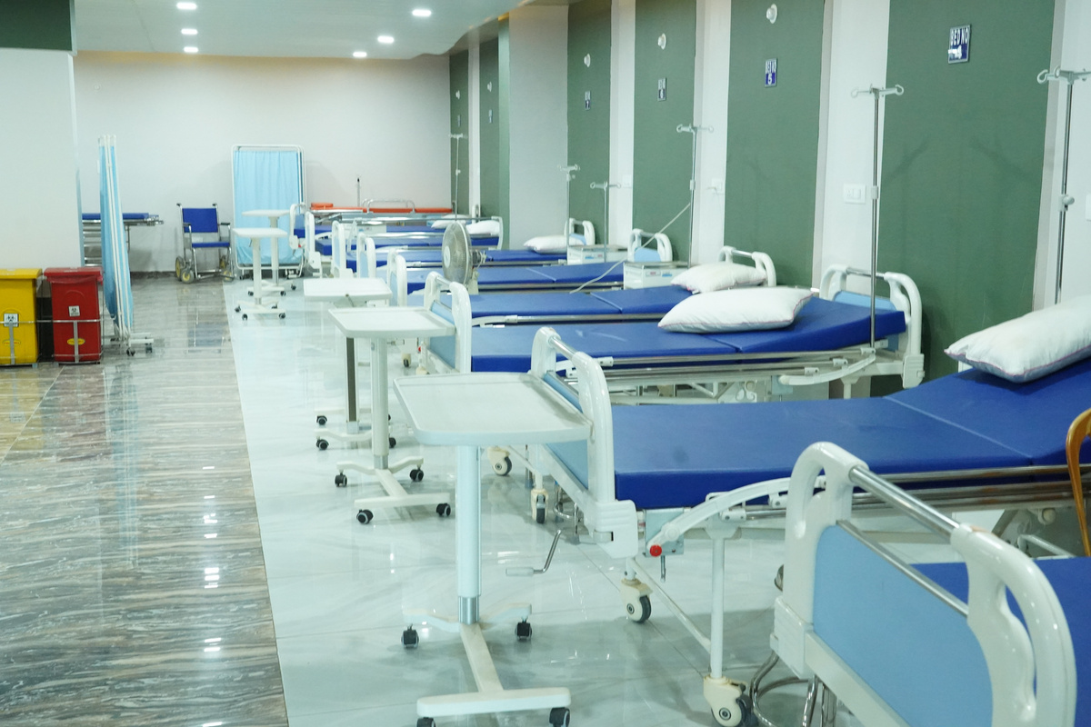

OUTCOMES OF THIS PORJECT
Effective Resource Monitoring
Provides visibility into the utilization, shortage, maintenance, and working hours of beds, equipment, and clinical staff.
Data-Driven Decision Support
Converts cleaned hospital data into meaningful visual insights that can support operational planning and resource management.

Slide 17
MedTrack_DV
DASHBOARD PROCESS
The MedTrack_DV Dashboard provides hospital staff and administrators with easy access to important operational information. Users can navigate through different dashboard views to monitor hospital performance, patient flow, department activity, and resource utilization. They can apply filters and analyze data based on hospitals, departments, and time periods. The dashboard presents KPIs, trends, and comparisons in a clear and interactive format. This helps users gain meaningful insights and support data-driven operational decisions.

Slide 18



Future Enhancement For THIS DASHBOARD
AI-Based Predictive Analytics
Integrate AI/ML models to predict future admissions, patient flow, resource demand, and possible hospital capacity requirements.
Real-Time Data Integration
Connect the dashboard with hospital systems to provide real-time updates on admissions, patient movements, bed availability, and resource utilization.
Automated Alerts & Recommendations
Introduce alerts for high occupancy, resource shortages, unusual patient-flow patterns, or maintenance requirements, along with data-based recommendations for hospital staff.

Slide 19
Questions
Questions
Questions
Q
&
A
Questions
Questions
Questions
Questions
Questions
Questions
Questions
Questions
Questions
Questions

Slide 20

Thank You For Your Valuable Time, Patience, And Attention.

